Slide 1
System Requirements
Functional Requirements
Non-Functional Requirements
HIL Test Tool
CAN Network
TCP Client
Test
Modes
HW
SW
HW
SW
SW

Slide 2
HW
SW
Test
Requirements Definition
Requirements Definition
Test Modes & Req. Definition
Project setup in IDE and I/O list
GPIO setup (STM32Cube IDE)
Create Simulated CAN Network
TFT Screen pin connection
CAN driver: callback setup & msg filters
Add ECU CAN msg to DB
B
CAN Transceiver connection
Ethernet (lwip) library setup
Create mock test cases for ECUs
DB9 pin connections
B
TCP Server lib setup
Execute CAN comm test
VN1640 case connection
FreeRTOS: setup
CAN test
Ethernet connection
FreeRTOS tasks definition
PING test
Test Modes definition
Finalize CANoe panels
Software Improvements
Test Modes EXEC
END

Slide 3
Application Code
CAN Handler
TCP Handler
Test Mode 1
Test Mode 2
Test Mode 3
Test Mode 4
MAIN Controller task
Hardware Abstraction Layer for GPIO
RTOS (FreeRTOS)
TCP Server lib
CAN driver
Peripheral drivers
(including SPI)
IRQs & Callbacks
Ethernet (LWIP) driver
MCU Hardware

Slide 4
TCP Client
HIL Test Tool
Simulated ECU
TCP conn request.
Connection accepted
Send command for
Test Mode
Test Mode EXEC
Test Mode Responses
TCP Notification and
Acknowledgement

Slide 5
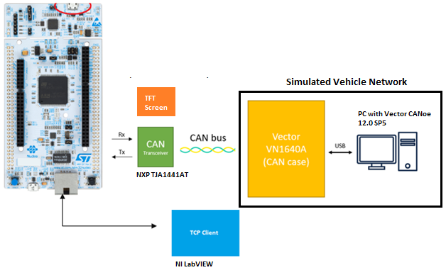
HIL Test Tool
STM32 Nucleo-H723ZG
FreeRTOS (10.1)
-CAN HS/FD
-Ethernet (TCP Server)
-SPI (1.8” ST7735 TFT screen)

